Slide 1
2.3 Reproducibility in MLOps
POSGRAD
MNA

Slide 2

Introduction
Reproducibility is the capacity to exactly replicate a model such that, when provided with the identical raw data input, the duplicated model yields the same output.
If the model cannot be reliably reproduced, users can lose trust in the results.

Slide 3
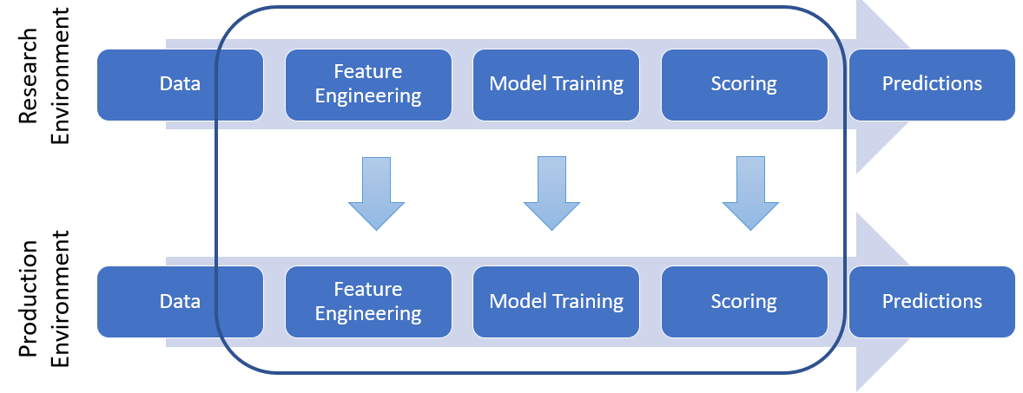
In the process of constructing a machine learning (ML) model, we operate across several distinct environments, usually encompassing research, development, and production stages.

Slide 4
Beyond the initial research, each stage aims to mimic the established pipeline, but the methods to achieve this vary significantly between environments.
This variation in methods introduced numerous challenges to maintaining reproducibility at every stage of the pipeline, from data collection to generating predictions with the model.

Slide 5
Challenges of Reproducibility in ML

Slide 6
Reproducibility in Data Gathering
The success of ML models is heavily reliant on the training data, and obtaining the right data is key to achieving reproducibility. A model will only produce the same output if trained with the same data and process.
As models transition to the production environment, they often lose access to the initial training data.

Slide 7

One workaround for smaller datasets is to capture a snapshot of the training data, storing it for subsequent use.
However, the optimal approach involves organizing data sources with precise timestamps, allowing for straightforward identification of the data utilized during model training.

Slide 8
Reproducibility in Feature Creation
Any parameters derived from the data will not remain the same unless the data is identical in all environments.
For example, if we use the mean to replace missing data and if the training data differs among environments, this difference will carry on into the mean as well.

Slide 9

Hyperparameters need to remain constant between environments as well. An example of this occurs when features rely on random samples. Reproducibility will not be achieved unless the same seed is set for every environment, and the random samples are generated using the same process.

Slide 10
Reproducibility in Model Building
ML algorithms introduce notable reproducibility challenges due to their reliance on randomness during training. This issue is prevalent in practices like feature creation and various model types, including tree ensembles, which use random selections of data and features; cross-validation, which partitions data randomly; and neural networks, with randomly initialized weights.

Slide 11

This inherent randomness leads to minor discrepancies between models trained on identical data, failing to fulfill reproducibility standards.

Slide 12
Reproducibility in Model Deployment
Reproducibility issues in model deployment often stem from misalignments and misunderstandings between data scientists, who develop initial models, and programmers, who integrate these models into business systems.
This disconnect frequently results in the training data not accurately representing the data encountered in live environments, due to unrecognized filters or a lack of understanding of the model's application in real-world scenarios.

Slide 13
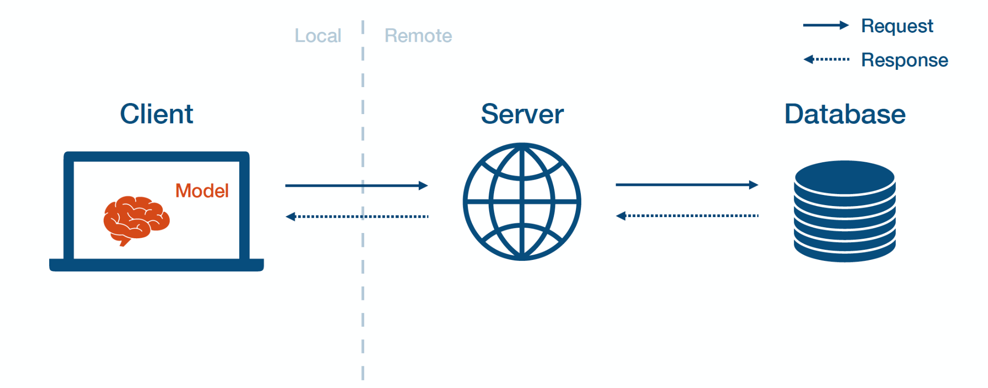
Furthermore, differences in programming languages between development and deployment phases increase the risk of errors, as code must be translated, increasing the likelihood of mistakes. Using a consistent programming language across all phases mitigates these issues.

Slide 14
Architecture for reproducible ML Pipelines.

Slide 15
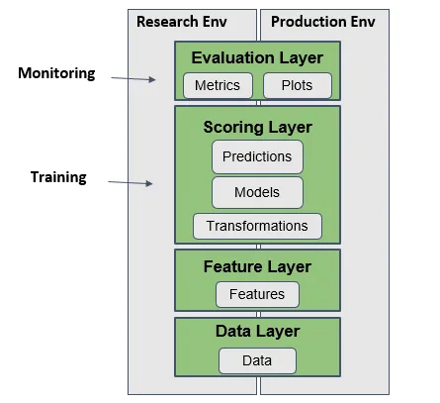
Architecture for Reproducibility
Adopting modularity by dividing the project into components enhances generality and scalability. The architecture will align with Scikit-learn's API conventions for compatibility, recognized as industry standards.
Data Layer
Feature Layer
Scoring Layer
Evaluation Layer

Slide 16
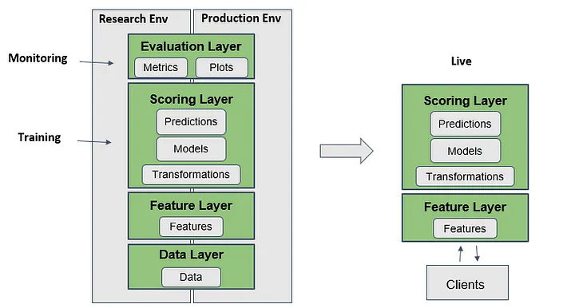
Assessment for Reproducibility
Ensuring models in both the production and research environments yield identical outputs when fed the same inputs is crucial for validating a system's reproducibility.
If discrepancies arise, one should iteratively refine the architecture until consistency is achieved.

Slide 17
When both models reliably produce matching results, the next phase involves integrating these models into an API to process live data and deliver real-time predictions to meet client demands.
This structured approach not only enhances the model's efficiency but also solidifies its reproducibility, leading to more dependable and verifiable machine learning workflows.
While adapting the system to meet these high reproducibility standards may be challenging, the effort is justified by the long-term benefits, ensuring the system aligns with the rigorous data and statistical requirements that are increasingly expected as machine learning becomes more prevalent and demanded.

Slide 18
Documentation and Reporting

Slide 19
Why documenting your ML Pipelines?
The documentation of your ML pipeline steps and outputs is an essential practice that enables:
Reproducibility
Collaboration
Maintenance and debugging
Auditing and compliance

Slide 20
What to include in your ML pipeline documentation?
High-level overview
Step descriptions
Purpose
Input and Output
Parameters and Hiperparameters
Dependencies
Code snippets
Notes:
- High-Level Overview: Begin with a concise summary of the pipeline's purpose, input data, and expected output. Consider using diagrams or flowcharts to visualize the overall structure.
- Step Descriptions: For each step, provide a detailed description. Include information such as:
- Purpose: Why does this step exist? What transformation or computation does it perform?
- Input: What data or artifacts does it consume?
- Output: What does it produce? Is it an intermediate result or the final output?
- Parameters and Hyperparameters: Specify any configurable settings.
- Dependencies: Note any dependencies on external libraries, services, or hardware.
- Code Snippets: Embed relevant code snippets within the documentation. These snippets should illustrate how to execute each step programmatically.

Slide 21
References:
How to build and deploy reproducible ML Pipeline, Galli S., 2020
How to solve reproducibility in ML

